Slide 1
Loading and Working with Textures in Three.js
Γ
gamma team – Computer Graphics 2021

Slide 2
Table of contents
06
01
LOAD TEXTURE
Simple texture app
SPECULAR MAP
07
02
FILTERING & MIPS
REPEAT WRAPPING
03
08
CREATE WRINKLES
CANVAS TEXTURE
Make wrinkles with bump map and normal map
Canvas as texture
04
09
Video as texture
FAKE SHADOWS
VIDEO TEXTURE
Creating a fake shadow using a light map
05
FAKE REFLECTION
Creating a fake shadow with an environment map

Slide 3
01
LOAD TEXTURE AND APPLYING TO MESH

Slide 4
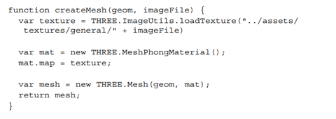
LOAD TEXTURE AND APPLYING TO MESH (1)
The basic use of textures is to make them into the material map. When a material is used to create a mesh, the mesh will be colored according to the texture used.​ ​Load texture with mesh can be done with the following code:​
The createMesh function above uses THREE.ImageUtils.loadTexture to display an image file (JPEG, GIF or PNG format) as an input texture.

Slide 5
LOAD TEXTURE AND APPLYING TO MESH (2)
Textures will load asynchronously, but that is overcome by a render loop (around 60x per second). But if you want to wait until the image texture is loaded perfectly, you can do this by:​
The function calls back to the load Texture, which is called when the texture is loaded.

Slide 6
Textures - Custom Loaders
THREE.DDSLloader
Load the texture in the DirectDraw Surface (dds) format, which is saved in the compressed texture.
To use it, just include DDSLoade.js and load the texture with the following code:
THREE.PVRLoader
Load textures in Power VR (pvr) format, which are saved in compressed textures. Three.js supports use of the Power VR 3.0 . format
To use it, just include PVRLoader.js and load the texture with the following code:
THREE.TGALoader
Load the texture in Targa (tga) format. This format is often used in 3D software programs.
To use it, just include TGALoader.js and load the texture with the following code:

Slide 7
02
FILTERING & MIPS

Slide 8
The Why
Since the pixels of a texture (or texels) often does not map one-to-one on the pixels of the face, the texture needs to be magnified or minified.
To achieve this, we can use filtering and mipmaps.

Slide 9
Filtering
In Three.js, you can specify how the texture is magnified by setting the magFilter property and how it is minified with the minFilter property. These properties can be set to the following two basic values:
THREE.NearestFilter This uses the colour of the nearest texel. When magnified, the texture will be blocky, and when minified, it will lose much detail.
THREE.LinearFilter This uses the colour value of the four neighbouring texels to determine the correct colour. The texture will still lose details when minified, but its magnification will be much smoother.

Slide 10
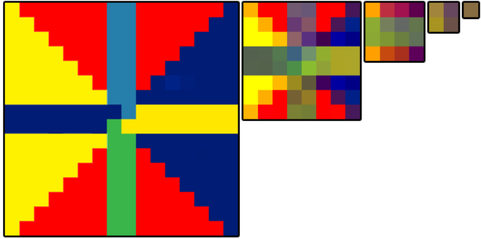
Mipmaps
Mipmaps or mips are a set of texture drawings, each half the size of the previous one.
Mips can be used alongside the filtering methods we mentioned earlier to get better minification.

Slide 11
Mipmaps (2)
THREE.NearestMipMapNearestFilter This uses the nearest mipmap to the required resolution and applies the nearest filter principle.
THREE.NearestMipMapLinearFilter This uses two nearest mipmap levels and applies the nearest filter at each level. These two results are then passed through a linear filter.
THREE.LinearMipMapNearestFilter This uses the nearest mipmap to the required resolution and applies the linear filter principle.
THREE.NearestMipMapLinearFilter This uses two nearest mipmap levels and applies the linear filter at each level. These two results are then passed through a linear filter.
In addition to the previous THREE.NearestFilter and THREE.LinearFilter values, Three.js provides additional values to define the behaviour of minFilter:
These values are only supported by minFilter, and thus we can only use mipmaps for minification.

Slide 12
03
CREATE WRINKLES

Slide 13
CREATE WRINKLES
Bump Map
Normal Map

Slide 14
BUMP MAP
Bump Map is used to add depth to a material.
Adding a Bump Map texture to the material will make the object look more detailed and deeper than objects that does not add a Bump Map to the texture.
an example of implementation will be explained in the next slide

Slide 15
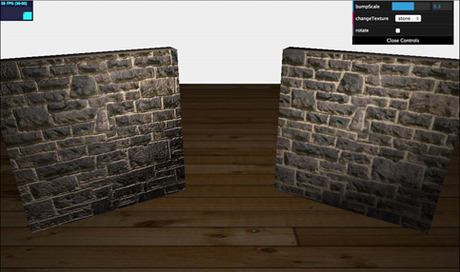
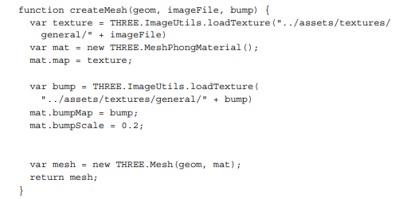
Bump Map (example)
In this example, you can see the left-hand side wall looks much more detailed and seems to have much more depth when you compare it with the wall on the right-hand side. This is done by setting an additional texture, called a bump map, on the material:

Slide 16
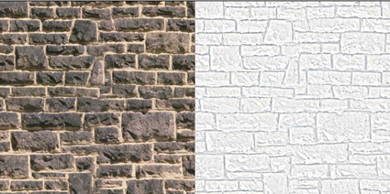
Bump Map (2)
The Bump Map is a greyscale (black - white) version of the texture image used. But Bump Map can also be a color image. The pixel intensity of the image determines the depth of the hollow.
Notes:
The Bump map only has a certain pixel depth, it doesn't depend on the direction, so for more details you can use the Normal map

Slide 17
Bump Map (3)
briefly, here are the summary points of the bump map :
Bump maps are usually grayscale images.
The pixel intensity determines the height of the bump.
The Bump Map contains only the relative heights of pixels, regardless of the direction of the slope.

Slide 18
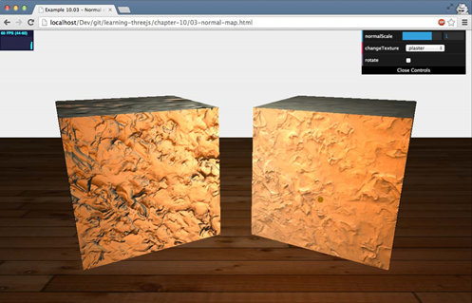
Normal Map
In normal map, elevation is not saved, but the normal direction for each image is saved.
With normal map, you can create very detail model that still only use a small number of vertices and faces.
On Normal Map, wrinkles don't depend on depth, but on direction. So the details texture will depend on the direction of view and the available light.
Notes:
That way the texture details on the normal map will be more visible, but the normal map application is not as easy as a bump map, because it requires Blender or Photoshop to produce a high-resolution texture input.
In this screenshot, you can see a very detailed plastered cube to the left. The light source moves around the cubes, and you can see that the texture responds naturally to the light source. This provides a very realistic-looking model and only requires a very simple model and a couple of textures.

Slide 19
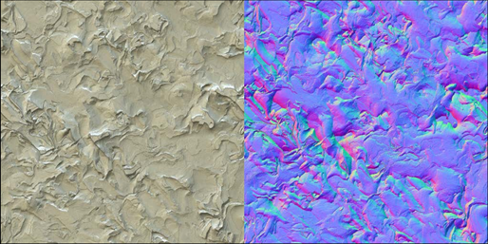
Normal Map(2)
The same approach is used here as was done for the bump map. This time, though, we set the normalMap property to the normal texture. We can also define how pronounced the bumps look by setting the normalScale property mat.normalScale.set(1,1).
With these two properties, you can scale along the x and y axes. The best approach, though, is to keep these values the same for the best effect. Note that once again, when these values are below zero, the heights inverse. The following screenshot shows both
the texture (on the left-hand side) and the normal map (on the right-hand side):

Slide 20
04
FAKE SHADOWS
Creating a fake shadow using a light map

Slide 21
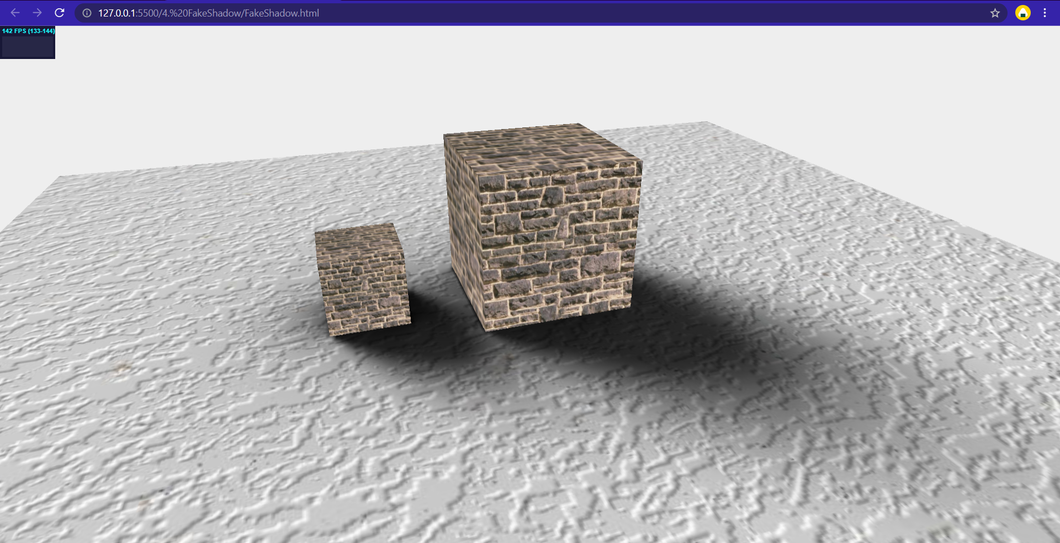
FAKE SHADOWS
In the previous topic , we used specific maps to create real-looking shadows that react to the lighting in the room. There is an alternative option to create fake shadows. In this section, we'll use a light map. A light map is a pre-rendered shadow (also called a prebaked shadow) that you can use to create the illusion of a real shadow
Here's a screenshot of an example of how fake shadows work :

Slide 22
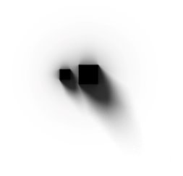
FAKE SHADOWS
If you look at the previous example, it shows a couple of very nice shadows, which seem to be cast by the two cubes. These shadows, however, are based on a light map texture that looks like the following:
As you can see, the shadows, as specified in the light map, are also shown as the shadows on the ground plane, creating the illusion of real shadows. You can use this technique to create high-resolution shadows, without incurring a heavy rendering penalty. This, of course, only works for static scenes. Using a light map is pretty much the same as using other textures with a couple of small differences

Slide 23
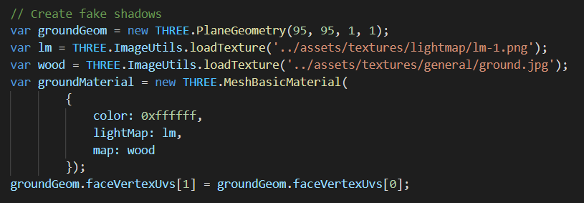
Using Light Map
To apply the light map, we just need to set the lightMap property of the material to the light map we just show up and then explicitly define the UV mapping (what part of the texture is shown on a face) for the light map.
When the shadow is positioned correctly, place the cubes in the correct location so that it looks as though the shadows are being cast by them.

Slide 24
05
FAKE REFLECTION
Creating a fake shadow using an environment map

Slide 25
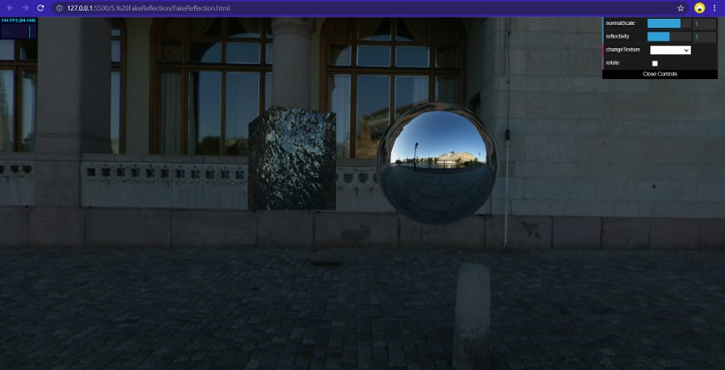
Environment Maps
To calculate environment reflections requires heavy CPU usage and a ray tracer approach.
We can make a fake reflection by creating a texture of the environment the object is in and apply this to the object.
This texture is what we call Environment Map

Slide 26
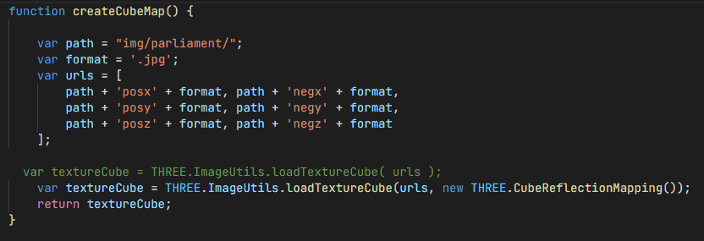
Creating Fake Reflections
Create a CubeMap object.
CubeMap is a set of six textures that can be applied to each side of a cube.

Slide 27
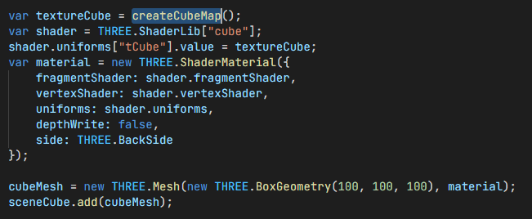
Creating Fake Reflections
Create a box with this CubeMap object.
This box is the environment you see when you move the camera around. It gives the illusion that you are standing in an environment. In reality, you are inside a cube with textures rendered on the inside.

Slide 28
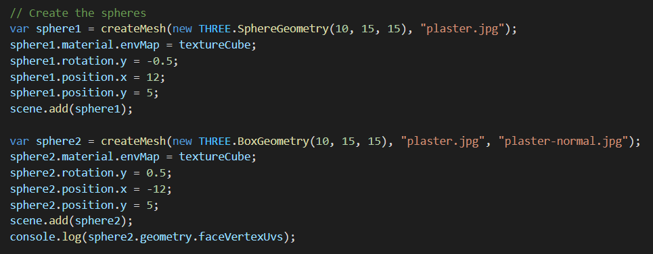
Creating Fake Reflections
Apply the CubeMap object as a texture.
The same CubeMap object used to simulate the environment can be used as a texture on the meshes.

Slide 29
06
SPECULAR MAP

Slide 30
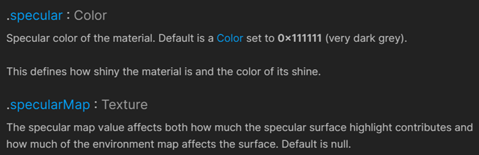
Specular Map
Define a map that defines the shininess and highlight color of a material.

Slide 31
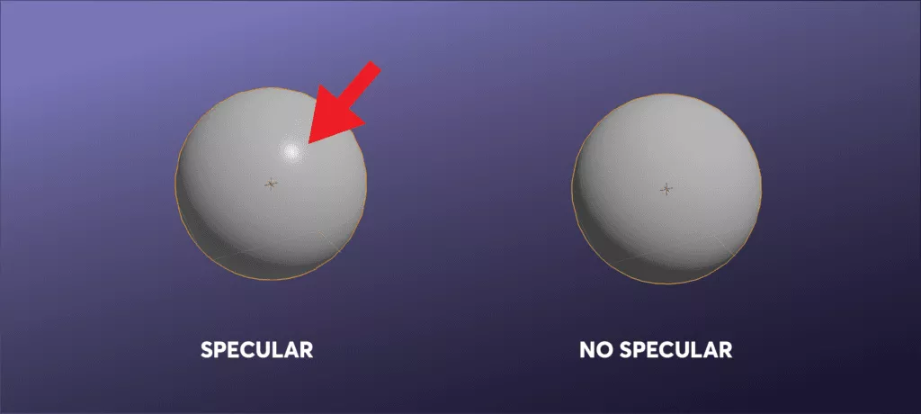
Specular Map
Specular maps are used to define the shininess/highlight on a surface. Typically a specular map is a black and white image that maps out the shininess value on an object. The whiter the pixel, the more shiny the object in that specific place on the texture (or on the texel).
Notes:
Specular: The specular coefficient describes the intensity of specular highlights. The higher the specular value, the brighter the resulting highlights.
Shininess: The shininess coefficient describes the breadth of the angle of specular reflection. The smaller the number the broader the angle and the rougher objects appear. The larger the value of shininess, the narrower the angle of specular reflection, and the smoother the surface. Default corresponds to a Phong exponent of 40.

Slide 32
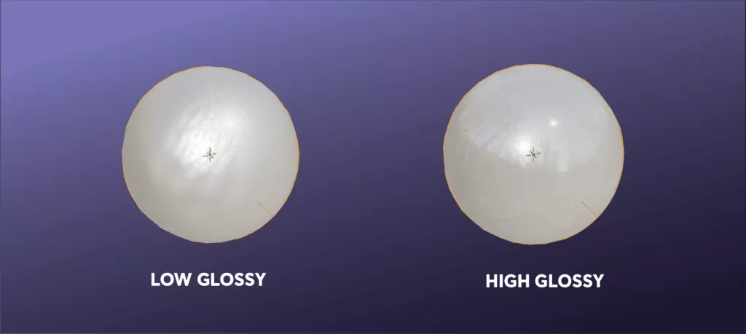
The Difference Between Specular and Glossy
Specular maps determine how much light will reflect off of a surface. In the range of black and white values, the whiter area will reflect more light, and the blacker areas less light. Gloss, on the other hand, determines how clear that reflection will be.

Slide 33
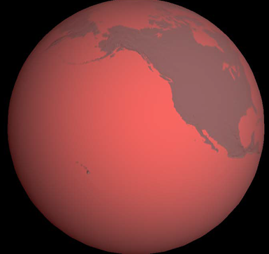
Specular Map
With Specular Map, we can define a map that defines the shininess and highlight of a material. For example, in the following screenshot, we have used the specular map along with the normal map to create a globe.
In this screenshot, we can see that the ocean is highlighted and reflects light. Continents, very dark and not reflecting light. For this effect, we don't use any specific normal texture, but just a normal map to display the elevation.
Notes:
Therefore, textures that arent shiny and that are more matt like stone or fabrics would have a very dark specular map. While other more shiny materials like chrome or plastic would have very bright specular maps.
You can play with the contrast of the specular map to make the highlights more intense to create interest in your objects. A specular map with high contrast will cause your object’s shininess to be more intense and deliberate, while a less contrasted image will mean your entire object will look shiny but a little bit shinier on other places. Only the very black areas of your image will mean that there is no shininess in that texel.

Slide 34
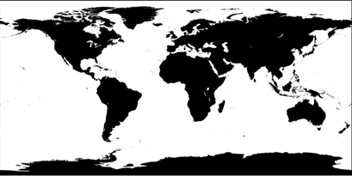
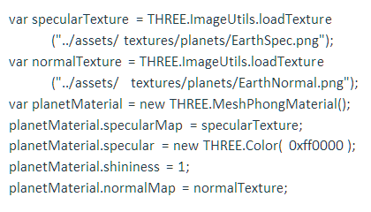
Specular Map
Basically, what happens is that the higher the pixel value (from black to white), the more glossy the surface will appear. Specular maps are usually used in conjunction with a specular property which we can use to define the reflection color.
Notes:
Specular: The specular coefficient describes the intensity of specular highlights. The higher the specular value, the brighter the resulting highlights.
Shininess: The shininess coefficient describes the breadth of the angle of specular reflection. The smaller the number the broader the angle and the rougher objects appear. The larger the value of shininess, the narrower the angle of specular reflection, and the smoother the surface. Default corresponds to a Phong exponent of 40.

Slide 35
07
REPEAT WRAPPING
Repeat wrapping on texture

Slide 36
REPEAT WRAPPING
The default texture application in three.js is to apply the texture thoroughly on each side of the geometry object. But there are times when we want the texture not to exist in a part, or we also want to repeat the texture itself.
Three.js provides a function to overcome this with Repeat Wrapping.

Slide 37
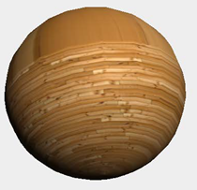
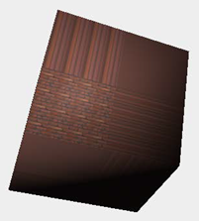
REPEAT WRAPPING
In Three.js, textures are applied to the geometry as a whole. For example, a cube on each side will have a full texture, and for a sphere it will have a full texture wrapped around the sphere. However, this texture can be arranged so that in a geometry it can describe a repeating texture.
In the example image, we can control how the texture will repeat itself, with code:
cube.material.map.wrapS = THREE.RepeatWrapping;
cube.material.map.wrapT = THREE.RepeatWrapping;
The wrapS property defines how we want the texture to shape along the x-axis and the wrapT property defines how the texture should shape along the y-axis.

Slide 38
REPEAT WRAPPING
Three.js provides two options for this, which are as follows:
• THREE.RepeatWrapping allows textures to repeat themselves.
• THREE.ClampToEdgeWrapping is the default setting. ClampToEdgeWrapping, the texture does not repeat as a whole, but only the pixels at the edges are repeated.
If we use THREE.RepeatWrapping, we can set the repeat property as shown in the following code fragment:
cube.material.map.repeat.set(repeatX, repeatY);
repeatX variable defines how often the texture is repeated along its x axis and repeatY variable defines the same for the y-axis.
Notes:
The repeatX variable defines how often the texture is repeated along the x-axis and the repeatY variable defines the same for the y-axis. If these values are set to 1, the texture will not repeat itself; if they are set to a higher value, we will see that the texture will start repeating itself. You can also use values less than 1. In this case, you can see that you will enlarge the texture. If you set the repeat value to a negative value, the texture will be mirrored.

Slide 39
08
CANVAS TEXTURE
Canvas as texture

Slide 40
CANVAS TEXTURE
Almost the same as the basic Texture class, only needs Update must be set to true immediately. Creates a texture using the canvas element as input and apply it to a mesh and the canvas can be used as a bump map using a randomly generated pattern.

Slide 41
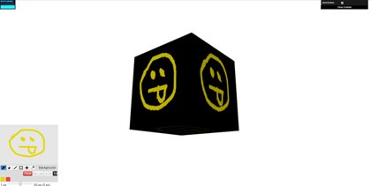
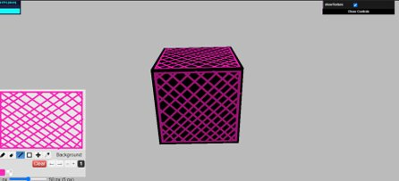
Using Canvas as a Texture
First example, we'll use Literally library to create an interactive canvas that we can draw on and then the image we draw on canvas can be used to the texture.

Slide 42
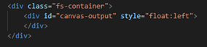
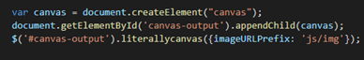
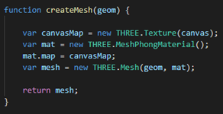
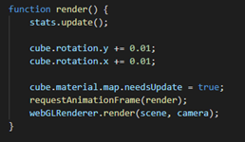
Using Canvas as a Texture
Create a canvas with the literallycanvas provided in the Literally library.
Create a texture that uses the canvas drawing as its input. In this case, we set Geometry Texture to the canvas.
Update the material so that the latest version of the canvas drawing is shown on the cube. In the render function, we set the material's needsUpdate property to true

Slide 43
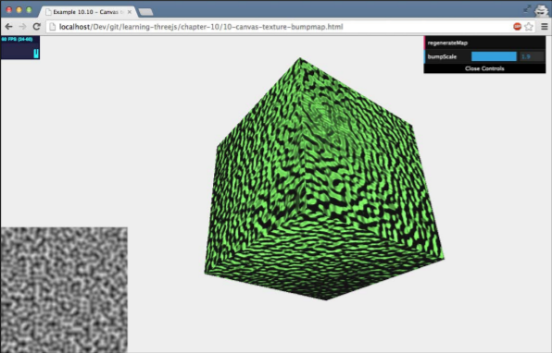
Using the Canvas as a Bump Map
As we've seen before, we can create a simple wrinkled texture with a bump map. Since a bump map is just a simple black-and-white image, also we can create this on a canvas and using canvas as an input for the bump map.

Slide 44
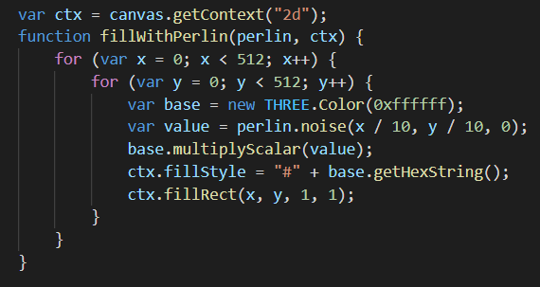
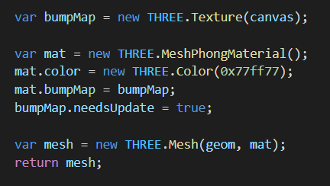
Create a canvas element and fill this canvas with some random noise. For example, we use Pelin Noise. Perlin Noise is a very natural-looking random texture as previous image.
With the perlin.noise function to create a value from 0 to 1 based on x and y. This value is used to draw a single pixel on the canvas. Doing this for all the pixels creates the random map. This map can be easily used as a bump map.

Slide 45
09
VIDEO TEXTURE
Video as texture

Slide 46
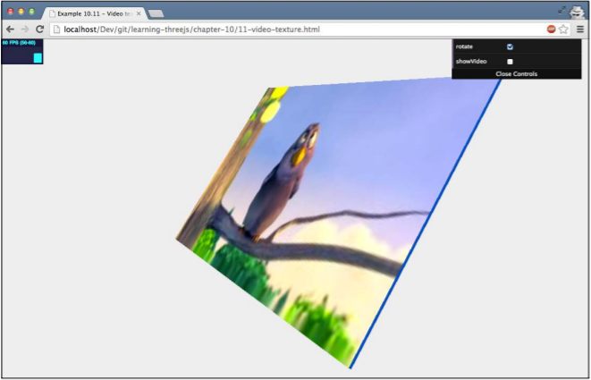
Video Texture
We can use a rendered video to canvas and using that as input for a texture using the HTML5 video element with Three.js.

Slide 47
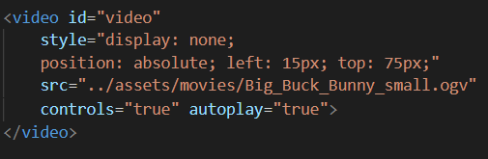
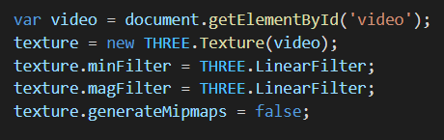
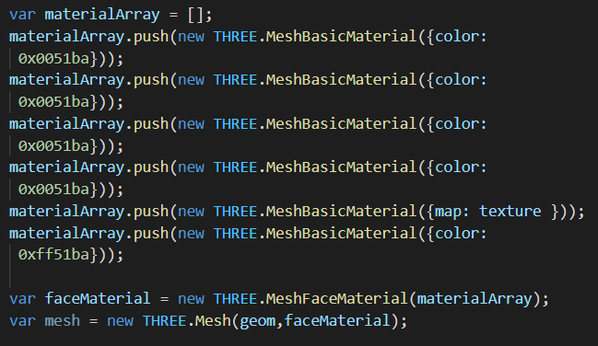
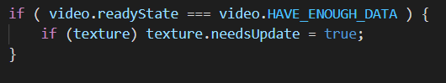
Using the Output from a Video as a Texture
Of course, we need to have a video element to play the video
Configure Three.js to use this video as an input for a texture by filling video on THREE.Texture function. And then disable mipmap since our video isn't square.
Create a mesh and set the texture, this example we used MeshFaceMaterial and MeshBasicMaterial.
Then update the texture with loop the render.

Slide 48
Thank You

Slide 49
Contents of this template
Here’s what you’ll find in this Slidesgo template:
A slide structure based on a thesis defense presentation, which you can easily adapt to your needs. For more info on how to edit the template, please visit Slidesgo School or read our FAQs.
An assortment of graphic resources that are suitable for use in the presentation can be found in the alternative resources slide.
A thanks slide, which you must keep so that proper credits for our design are given.
A resources slide, where you’ll find links to all the elements used in the template.
Instructions for use.
Final slides with:
The fonts and colors used in the template.
A selection of illustrations. You can also customize and animate them as you wish with the online editor. Visit Storyset to find more.
More infographic resources, whose size and color can be edited.
Sets of customizable icons of the following themes: general, business, avatar, creative process, education, help & support, medical, nature, performing arts, SEO & marketing, and teamwork.
You can delete this slide when you’re done editing the presentation.

Slide 50
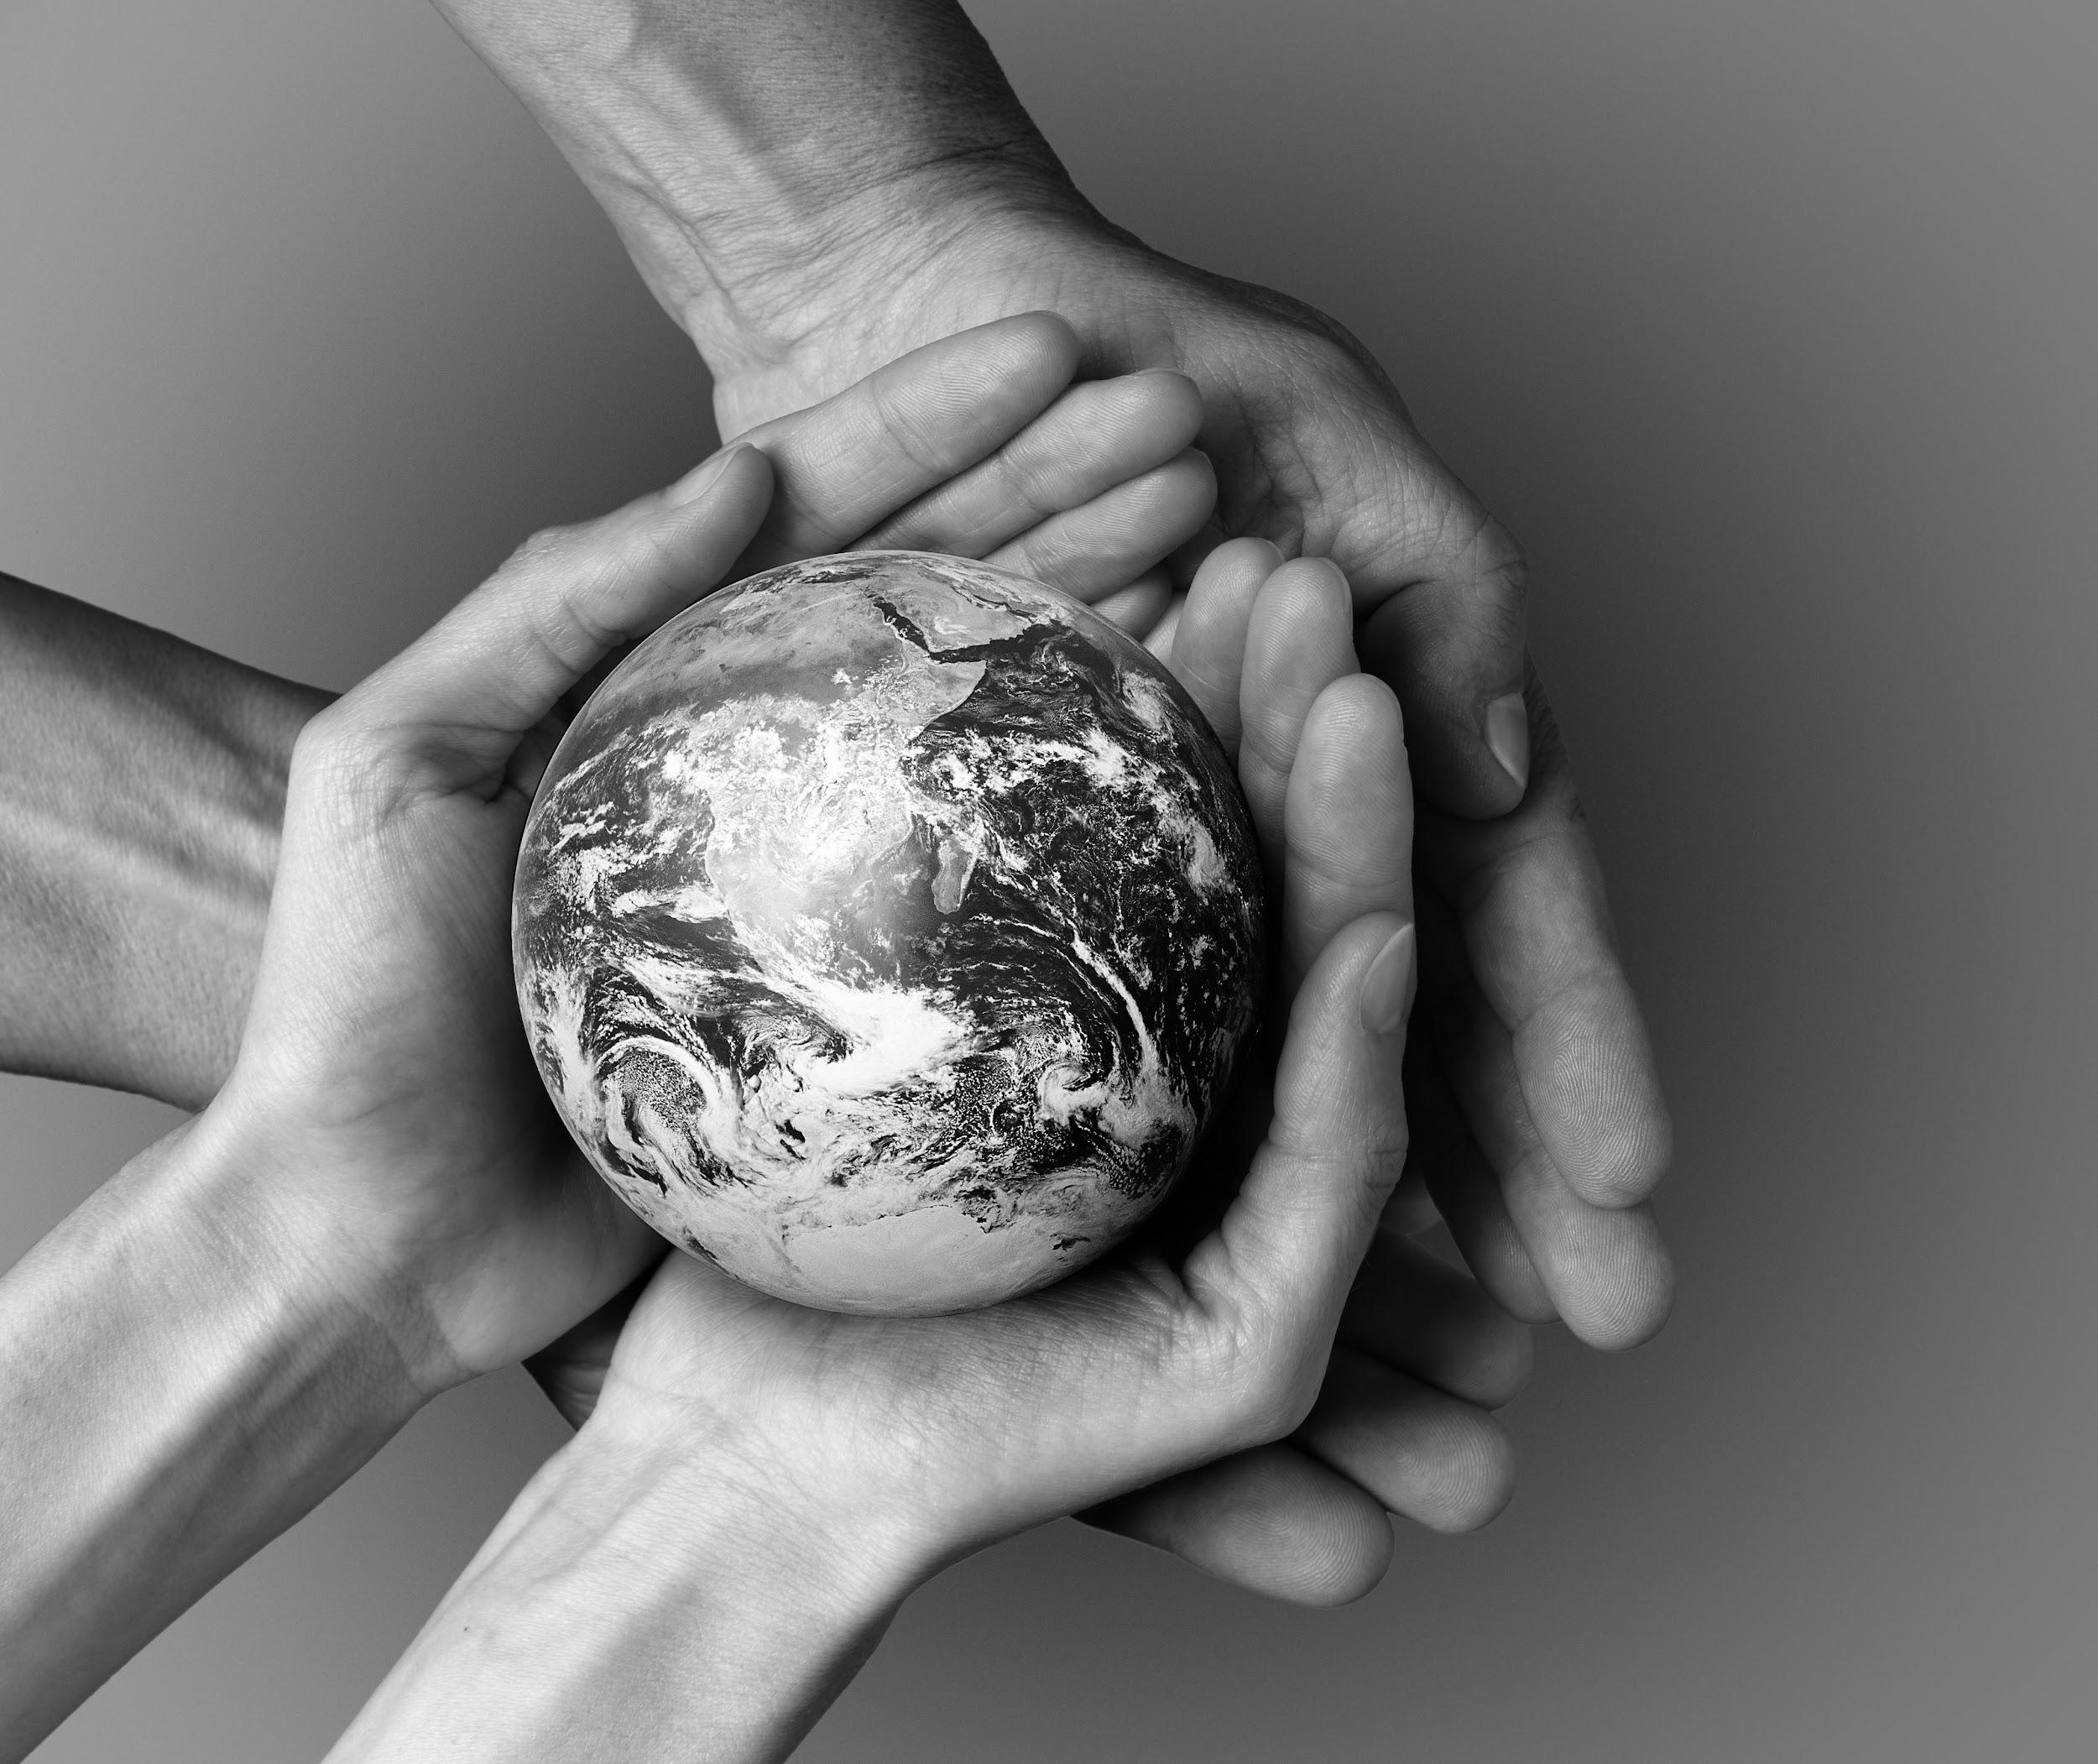
Introduction
Do you know what helps you make your point clear? Lists like this one:
They’re simple
You can organize your ideas clearly
You’ll never forget to buy milk!
And the most important thing:
the audience won’t miss the point of your presentation

Slide 51
— Someone Famous
“This is a quote. Words full of wisdom that someone important said and can make the reader get inspired.”

Slide 52
Schedule
Mon | Tue | Wed | Thu | Fri | Sat | Sun
 |  |  |  |  |  | 1
2 | 3 | 4 | 5 | 6 | 7 | 8
9 | 10 | 11 | 12 | 13 | 14 | 15
16 | 17 | 18 | 19 | 20 | 21 | 22
23 | 24 | 25 | 26 | 27 | 28 | 29
30 | 31
31
Venus has a beautiful name and is the second planet from the Sun

Slide 53
01
Objectives
Venus has a beautiful name and is the second planet from the Sun. It’s hot and has a poisonous atmosphere out there

Slide 54
Literature review
Mercury
Venus
Mercury is the closest planet to the Sun and the smallest one in the Solar System—it’s only a bit larger than the Moon
Venus has a beautiful name and is the second planet from the Sun. It’s hot and has a poisonous atmosphere out there

Slide 55
Study objectives
Mercury
Venus
Mars
Mercury is the closest planet to the Sun and the smallest one in the System
Venus has a beautiful name and is the second planet from the Sun. It’s very hot
Despite being red, Mars is a cold place, not hot. The planet is full of iron oxide dust

Slide 56
Methodology
Research
Analysis
Venus has a beautiful name, but it’s terribly hot
Jupiter is the biggest planet in our Solar System
Data study
Comparison
Despite being red, Mars is a cold place, not hot
Saturn is the ringed one planet and a gas giant

Slide 57

A picture is worth a thousand words

Slide 58
Comparison
 | Test 1 | Test 2 | Test 3
Describe here your metrics 1
Describe here your metrics 2
Describe here your metrics 3

Slide 59
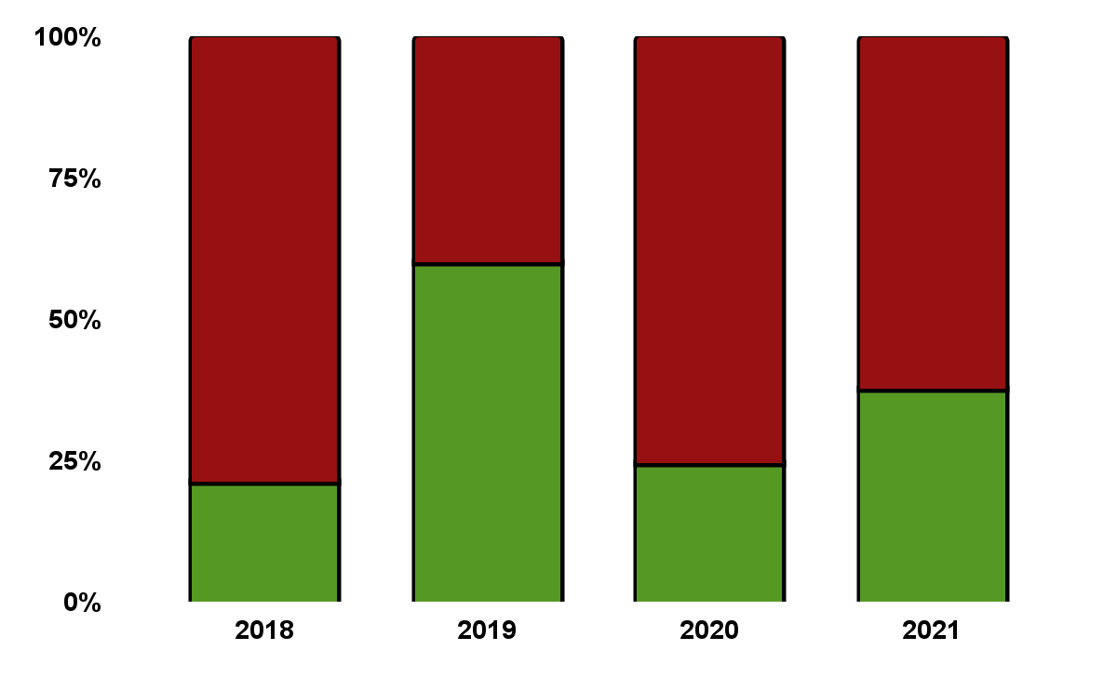
Analysis results
Venus
Venus has a beautiful name, but it’s terribly hot
Mars
Despite being red, Mars is a cold place, not hot
Follow the link in the graph to modify its data and then paste the new one here. For more info, click here

Slide 60
This is a map
Jupiter
Jupiter is the biggest planet in our Solar System
Saturn
Saturn is the ringed one planet and a gas giant

Slide 61
Percentages
Venus
Mars
Jupiter
75%
50%
25%
Venus has a beautiful name, but it’s terribly hot
Despite being red, Mars is a cold place, not hot
Jupiter is the biggest planet in our Solar System

Slide 62
Awesome words

Slide 63
Conclusions
Venus
Jupiter
Mars
Venus has a nice name
Jupiter is the biggest one
Mars is a cold place
Mercury
Saturn
Neptune
Mercury is the smallest
Saturn is the ringed one
Neptune is very far

Slide 64
2,677,972
Big numbers catch your audience’s attention

Slide 65
This is a timeline
01
03
Mercury
Jupiter
Mercury is the smallest
Jupiter is the biggest one
Venus
Saturn
Venus is a hot planet
Saturn is the ringed one
02
04

Slide 66
Bibliographical references
AUTHOR (YEAR). Title of the publication. Publisher
AUTHOR (YEAR). Title of the publication. Publisher
AUTHOR (YEAR). Title of the publication. Publisher
AUTHOR (YEAR). Title of the publication. Publisher
AUTHOR (YEAR). Title of the publication. Publisher
AUTHOR (YEAR). Title of the publication. Publisher
AUTHOR (YEAR). Title of the publication. Publisher
AUTHOR (YEAR). Title of the publication. Publisher
AUTHOR (YEAR). Title of the publication. Publisher

Slide 67

Desktop Software
You can replace the image on the screen with your own work. Just right-click on it and select “Replace image”

Slide 68
Thanks!
Does anyone have any questions?
addyouremail@freepik.com
+91 620 421 838
yourcompany.com
Please keep this slide for attribution

Slide 69
Ramadan: Icon Pack

Slide 70
Alternative resources
Here’s an assortment of alternative resources whose style fits the one of this template:
Photos
Community concept with hands of people
Creative world book day arrangement
Community concept with hands of people
Vectors
Abstract blurred gradient mesh background
Abstract blurred gradient mesh background
Gradient abstract blurred covers collection

Slide 71
Resources
Did you like the resources on this template? Get them for free at our other websites:
Photos
People holding the earth in their hands
Creative world book day composition
Vectors
Abstract blurred gradient mesh background
Icons
Icon Pack: Ramadan

Slide 72
Instructions for use
In order to use this template, you must credit Slidesgo by keeping the Thanks slide.
You are allowed to:
- Modify this template.
- Use it for both personal and commercial projects.
You are not allowed to:
- Sublicense, sell or rent any of Slidesgo Content (or a modified version of Slidesgo Content).
- Distribute Slidesgo Content unless it has been expressly authorized by Slidesgo.
- Include Slidesgo Content in an online or offline database or file.
- Offer Slidesgo templates (or modified versions of Slidesgo templates) for download.
- Acquire the copyright of Slidesgo Content.
For more information about editing slides, please read our FAQs or visit Slidesgo School:
https://slidesgo.com/faqs and https://slidesgo.com/slidesgo-school

Slide 73
Instructions for use (premium users)
As a Premium user, you can use this template without attributing Slidesgo or keeping the "Thanks" slide.
You are allowed to:
Modify this template.
Use it for both personal and commercial purposes.
Hide or delete the “Thanks” slide and the mention to Slidesgo in the credits.
Share this template in an editable format with people who are not part of your team.
You are not allowed to:
Sublicense, sell or rent this Slidesgo Template (or a modified version of this Slidesgo Template).
Distribute this Slidesgo Template (or a modified version of this Slidesgo Template) or include it in a database or in any other product or service that offers downloadable images, icons or presentations that may be subject to distribution or resale.
Use any of the elements that are part of this Slidesgo Template in an isolated and separated way from this Template.
Register any of the elements that are part of this template as a trademark or logo, or register it as a work in an intellectual property registry or similar.
For more information about editing slides, please read our FAQs or visit Slidesgo School:
https://slidesgo.com/faqs and https://slidesgo.com/slidesgo-school

Slide 74
Fonts & colors used
This presentation has been made using the following fonts:
Darker Grotesque
(https://fonts.google.com/specimen/Darker+Grotesque)
Montserrat
(https://fonts.google.com/specimen/Montserrat)
#000000
#ffffff
#981112
#569824

Slide 75





Storyset
Create your Story with our illustrated concepts. Choose the style you like the most, edit its colors, pick the background and layers you want to show and bring them to life with the animator panel! It will boost your presentation. Check out How it Works.
Pana
Amico
Bro
Rafiki
Cuate

Slide 76
Use our editable graphic resources...
You can easily resize these resources without losing quality. To change the color, just ungroup the resource and click on the object you want to change. Then, click on the paint bucket and select the color you want. Group the resource again when you’re done. You can also look for more infographics on Slidesgo.

Slide 79
JANUARY
FEBRUARY
MARCH
APRIL
MAY
JUNE
PHASE 1
Task 1
Task 2
PHASE 2
Task 1
Task 2
JANUARY
FEBRUARY
MARCH
APRIL
PHASE 1
Task 1
Task 2

Slide 82
...and our sets of editable icons
You can resize these icons without losing quality.
You can change the stroke and fill color; just select the icon and click on the paint bucket/pen.
In Google Slides, you can also use Flaticon’s extension, allowing you to customize and add even more icons.

Slide 83
Educational Icons
Medical Icons

Slide 84
Business Icons
Teamwork Icons

Slide 85
Help & Support Icons
Avatar Icons

Slide 86
Creative Process Icons
Performing Arts Icons

Slide 87
Nature Icons

Slide 88
SEO & Marketing Icons

Slide 89


